Slide 1

Software engineering (Undergraduate)
software engineering
CSC 3112
(Undergraduate)
Chapter 5
XP & Scrum
Zinniya Taffannum pritee
Lecturer, CS, AIUB
Zinniya.pritee@aiub.edu

Slide 2
Extreme programming
Slide - 2
Evolved from the problems caused by the long development cycles of traditional development models (Beck 1999a).
First started as 'simply an opportunity to get the job done‘ (Haungs 2001) with practices that had been found effective in software development processes during the preceding decades (Beck 1999b)
Method is formed around common sense principles and simple to understand practices
  No process fits every project, rather, simple practices should be tailored to suit an individual project
SB

Slide 3
Xp values
Slide - 3
Communication: XP has a culture of oral communication and its practices are designed to encourage interaction.
“Problems with projects can invariably be traced back to somebody not talking to
somebody else about something important.”
Simplicity: Design the simplest product that meets the customer’s needs. An important aspect of the value is to only design and code what is in the current requirements rather than to anticipate and plan for unstated requirements.
SB

Slide 4
Xp values
Slide - 4
Feedback: The development team obtains feedback from the customers at the end of each iteration and external release. This feedback drives the next iteration.
Courage: Allow the team to have courage in its actions and decision making. For example, the development team might have the courage to resist pressure to make unrealistic commitments.
Respect: Team members need to care about each other and about the project.
SB

Slide 5
Xp process Model
Slide - 5
The life cycle of XP consists of six phases:
Exploration
Planning
Iterations to Release
Productionizing
Maintenance
Death
SB

Slide 6
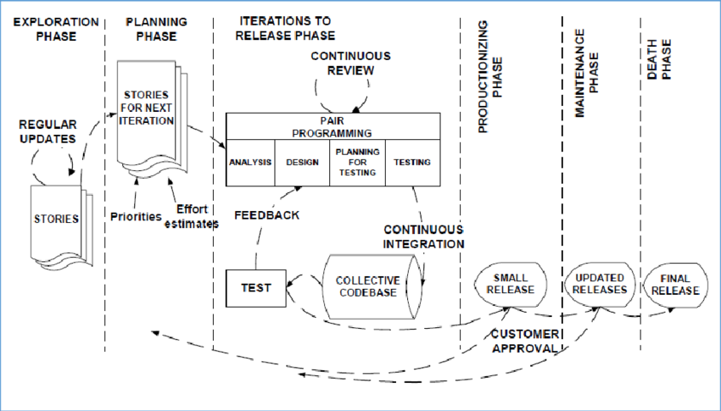
Slide - 6
SB

Slide 7
Xp process – Exploration phase
Slide - 7
The customers write out the story cards that they wish to be included in the first release
At the same time the project team familiarize themselves with the tools, technology and
practices they will be using in the project
The exploration phase takes between a few weeks to a few months, depending largely on
how familiar the technology is to the programmers
SB

Slide 8
Xp process – planning phase
Slide - 8
  Users stories are written
Estimate the effort of working with the user stories
Priorities are given to the user stories to be implemented
Release planning creates the release schedule
SB

Slide 9
Xp process – iterations to release phase
Slide - 9
Includes several iterations of the systems before the first release
Each takes one to four weeks to implement
The first iteration creates a system with the architecture of the whole system.
This is achieved by selecting the stories that will enforce building the structure
for the whole system
The customer decides the stories to be selected for each iteration
At the end of the last iteration, the system is ready for production
SB

Slide 10
Xp process – productionizing phase
Slide - 10
Requires extra testing and checking of the performance of the system before the system
can be released to the customer
New changes may still be found and the decision has to be made if they are included in the
current release
The iterations may need to be quickened from three weeks to one week
The postponed ideas and suggestions are documented for later implementation
SB

Slide 11
Xp process – maintenance phase
Slide - 11
After the first release is productionized for customer use, the XP project must both keep
the system in the production running while also producing new iterations
Requires an effort also for customer support tasks
Development velocity may decelerate after the system is in production
May require incorporating new people into the team and changing the team structure
SB

Slide 12
Xp process – death phase
Slide - 12
When the customer does no longer have any stories to be implemented
System satisfies customer needs also in other respects (e.g., concerning performance
and reliability)
Necessary documentation of the system is finally written as no more changes to the
architecture, design or code are made
Death may also occur if the system is not delivering the desired outcomes, or if it becomes
too expensive for further development
SB

Slide 13
Xp - Roles and responsibility
Slide - 13
Customer: writes the stories and functional tests, and decides when each requirement is
satisfied. The customer sets the implementation priority for the requirements
Programmer: keeps the program code as simple and definite as possible.
Tester: helps the customer write functional tests, also run functional tests regularly,
broadcast test results and maintain testing tools
Tracker: gives feedback in XP. He traces the estimates made by the team (e.g.
effort estimates) and gives feedback on how accurate they are in order to improve future
estimations. He also traces the progress of each iteration and evaluates whether the goal
is reachable within the given resource and time constraints or if any changes are needed in
the process
SB

Slide 14
Xp - practices
Slide - 14
Pair programming
  Two people write the code at one computer
  One programmer, the driver, has control of the keyboard/mouse and actively
  implements the program. The other programmer, the observer, continuously
  observes the work of the driver to identify tactical defects (syntactic, spelling, etc.)
  and also thinks strategically about the direction of the work.
  Two programmers can brainstorm any challenging problem. Because they periodically
  switch roles.
Continuous integration: A new piece of code is integrated into the code-base as soon
as it is ready.
SB

Slide 15
Xp - practices
Slide - 15
40-hour week: A maximum of 40-hour working week
On-site customer: Customer has to be present and available full-time for the team
Coding standards: Coding rules exist and are followed by the programmers (e.g. error message by exception handling). Communication through the code should be emphasized
Open workspace: A large room with small cubicle (compartment) is preferred
Just rules: Team has its own rules that are followed but can also be changed at any time.
The changes have to be agreed upon and their impact has to be assessed
SB

Slide 16
Xp - artefacts
Slide - 16
User story cards
  Paper index cards which contain brief requirement (features, non-functional) descriptions
  Not a full requirement statement
  Commitment for further conversation between the developer and the customer
  During this conversation, the two parties will come to an oral understanding of what is needed for the requirement to be fulfilled
  Customer priority and developer resource estimate are added to the card
  The resource estimate for a user story must not exceed the iteration duration
SB

Slide 17
Xp - artefacts
Slide - 17
Task list
  A listing of the tasks (one-half to three days in duration) for the user stories that are to be completed for an iteration
  Tasks represent concrete aspects of a user story
  Programmers volunteer for tasks rather than are assigned to tasks
SB

Slide 18
Scrum Model
Slide - 18
The first references in the literature to the term 'Scrum‘ point to the article of Takeuchi and Nonaka (1986) in which an adaptive, quick, self-organizing product development process originating from Japan is presented (Schwaber and Beedle 2002).
The term 'scrum' originally derives from a strategy in the game of rugby where it denotes "getting an out-of play ball back into the game" with teamwork (Schwaber and Beedle 2002).
SCRUM process includes three phases
  Pre-game
  Game phase (development)
  Post-game
SB

Slide 19
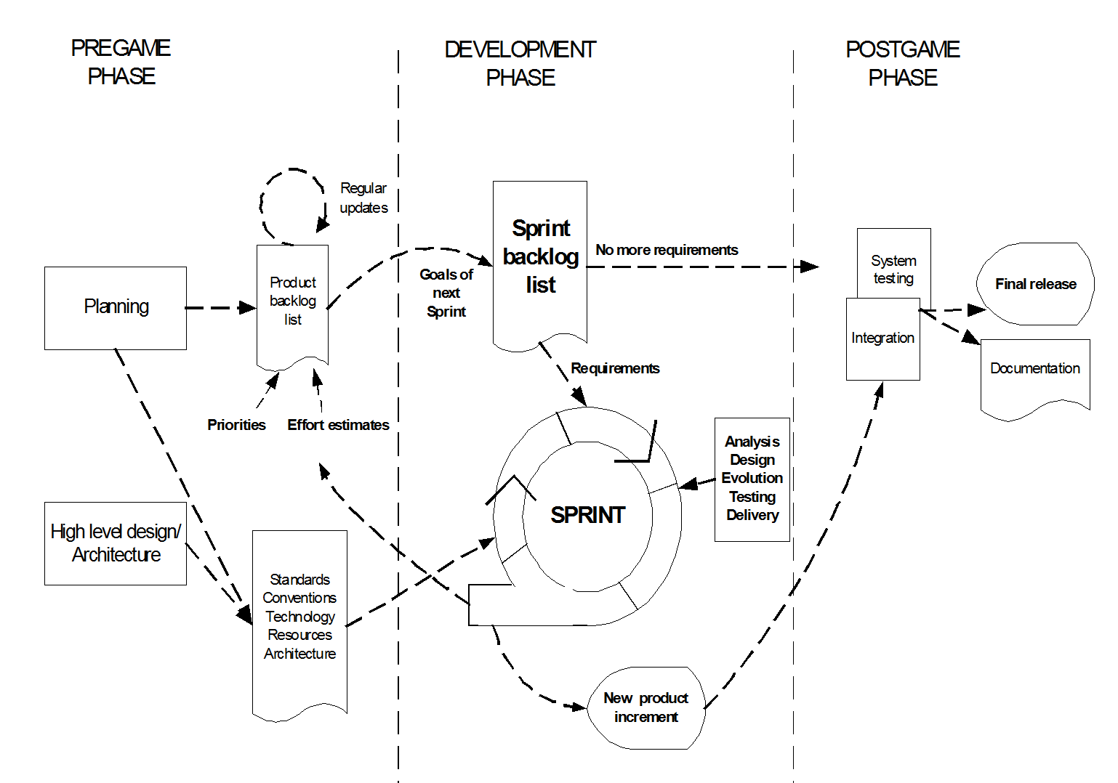
Scrum process
Slide - 19
SB

Slide 20
Pre-game phase
Slide - 20
The pre-game phase includes two sub-phases:
1. Planning:
Definition of the system being developed
A Product Backlog list is created containing all the requirements that are currently known
The requirements are prioritized and the effort needed for their implementation is estimated
The product Backlog list is constantly updated with new and more detailed items, as well as with more accurate estimations and new priority orders
Planning also includes the definition of the project team, tools and other resources, risk assessment and controlling issues, training needs and verification management approval
SB

Slide 21
Pre-game phase
Slide - 21
2. Architecture
The high level design of the system including the architecture is planned based on the current items in the Product Backlog
In case of an enhancement to an existing system, the changes needed for implementing the Backlog items are identified along with the problems they may cause
A design review meeting is held to go over the proposals for the implementation and decisions are made on the basis of this review
SB

Slide 22
Development (game) phase
Slide - 22
This phase is treated as a "black box" where the unpredictable is expected
The system is developed in Sprints
  Sprints are iterative cycles where the functionality is developed or enhanced to produce new increments.
  Each Sprint includes the traditional phases of software development: requirements, analysis, design, evolution and delivery phases.
  One Sprint is planned to last from one week to four week (not exceed one month).
SB

Slide 23
Post-game phase
Slide - 23
This phase is entered when an agreement has been made such as the requirements are completed.
In this case, no more items and issues can be found nor can any new ones be invented.
The system is now ready for the release and the preparation for this is done during the post-game phase, including the tasks such as the integration, system testing and documentation.
SB

Slide 24
Roles and responsibilities
Slide - 24
Scrum Master
Scrum Master is responsible for ensuring that the project is carried through according to the practices, values, and rules of Scrum and that it progresses as planned.
Scrum Master interacts with the project team as well as with the customer and the management during the project.
Product Owner
Product Owner is officially responsible for the project, managing, controlling, and making visible the Product Backlog list.
He is selected by the Scrum Master, the customer, and the management.
He makes the final decisions of the tasks related to product Backlog.
SB

Slide 25
Roles and responsibilities
Slide - 25
Scrum Team
Scrum Team is the project team that has the authority to decide on the necessary actions and to organize itself in order to achieve the goals of each Sprint.
The scrum team is involved, for example, in effort estimation, creating the Sprint Backlog, reviewing the product Backlog list and suggesting impediments that need to be removed from the project.
Customer
Customer participates in the tasks related to product Backlog items for the system being developed or enhanced.
Management
Management is in charge of final decision making, along with the agreements, standards, and conventions to be followed in the project.
Management also participates in the setting of goals and requirements.
SB

Slide 26
Scrum practices
Slide - 26
Product Backlog & Sprint
Sprint is the procedure of adapting to the changing environmental variables (requirements, time, resources, knowledge, technology etc.).
The working tools of the team are Sprint Planning Meetings, Sprint Backlog, and Daily Scrum meetings.
Effort Estimation & Sprint Backlog
Sprint Backlog is the starting point for each Sprint. It is a list of Product Backlog items selected to be implemented in the next Sprint.
The items are selected by the Scrum Team together with the Scrum Master and the Product Owner in the Sprint Planning meeting, on the basis of the prioritized items and goals set for the Sprint.
Unlike the Product Backlog, the Sprint Backlog is stable until the Sprint (i.e. 30 days) is completed. When all the items in the Sprint Backlog are completed, a new iteration of the system is delivered.
SB

Slide 27
Scrum practices
Slide - 27
Sprint Planning meeting
A Sprint Planning Meeting is a two-phase meeting organized by the Scrum Master.
The Scrum Master, Management, Product Owner, and Scrum Team participate in the first phase of the meeting to decide upon the goals and the functionality of the next Sprint.
The second phase of the meeting is held by the Scrum Master and the Scrum Team focusing on how the product increment is implemented during the Sprint.
Daily Scrum meeting
Daily Scrum meetings are organized to keep track of the progress of the Scrum Team continuously and they also serve as planning meetings: what has been done since the last meeting and what is to be done before the next one.
Sprint Review meeting
On the last day of the Sprint, the Scrum Team and the Scrum Master present the results (i.e. working product increment) of the Sprint to the management, customers, users, and the Product Owner in an informal meeting.
SB

Slide 28
references
Slide - 28
R.S. Pressman & Associates, Inc. (2010). Software Engineering: A Practitioner’s Approach.
Kelly, J. C., Sherif, J. S., & Hops, J. (1992). An analysis of defect densities found during software inspections. Journal of Systems and Software, 17(2), 111-117.
Bhandari, I., Halliday, M. J., Chaar, J., Chillarege, R., Jones, K., Atkinson, J. S., & Yonezawa, M. (1994).
In-process improvement through defect data interpretation. IBM Systems Journal, 33(1), 182-214.
SB

